Slide 1
Clauses
Glossary of Linguistic Terms
https://glossary.sil.org/term/clause

Slide 2
What do you know about clauses so far? (use chat)

Slide 3
What is a clause?
Definition:
A clause is a grammatical unit that:
includes, at minimum, a predicate and an explicit or implied subject
expresses a proposition.

Slide 4
Clause types give example for each (use chat)
Declarative (statements)
Interrogative (questions)
Imperative (commands)
Exclamative (exclamations)

Slide 6
Types of clauses
Kinds:
Adverbial Clause
Coordinate Clause
Existential Clause
Finite Clause
Main Clause
Nominal Clause
Nonfinite Clause
Relative Clause
Subordinate Clause
https://glossary.sil.org/term/clause (Glossary of Linguistic Terms)

Slide 7
Examples:
The following example sentence contains two clauses:
It is cold, although the sun is shining.
The main clause is it is cold and the subordinate clause is although the sun is shining.

Slide 8
clauses
Coordinate and subordinate clauses

Slide 9
Coordinate clause
Definition:
A coordinate clause is a clause belonging to a series of two or more clauses which:
are not syntactically dependent one on another
are joined by means of
a coordinating conjunction
a connective
parataxis

Slide 10
Examples:
I will go home and he will go to work.
John likes hamburgers, but Mary prefers hot dogs.
We might go to Seattle, or we might go to California.

Slide 11
Subordinate clause
Definition:
A subordinate clause is a clause that is embedded as a constituent of a matrix sentence and that functions like a noun, adjective, or adverb in the resultant complex sentence
Nominal, relative, adverbial

Slide 12
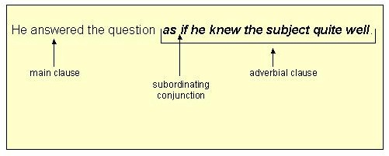
Analysis of Sentence

Slide 13
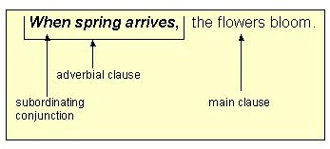
Analysis of sentence

Slide 14
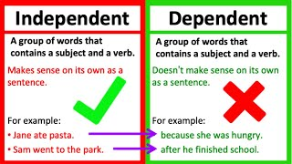

Slide 15
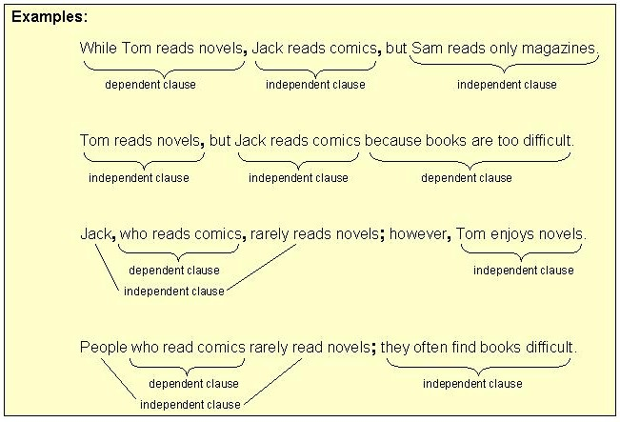
Compound- complex sentences

Slide 16
What is a nominal clause?
Definition:
A nominal clause is a subordinate clause that functions as a noun phrase.
(Glossary of Linguistic Terms, 2021).
https://glossary.sil.org/term/nominal-clause

Slide 17
Examples:
(English)
I know that he is here.
"But I still haven't found what I'm looking for." — U2.
I am pleased (that) you are studying in Dept. of English and American Studies.
We have been told that the examination starts this week. (We have been told what)

Slide 18
Noun clauses are not modifiers; they are placeholders
For example:
Noun Clause (acting as a subject): When she arrives is dependent on traffic/depends on traffic.
Adverbial Clause (acting as an adverb): When she arrives, we will eat dinner.

Slide 19
Can you identify a noun clause?
No one knows why she is afraid of lizards.
Unless you run fast, you will miss the bus.
I do not know what he does
If you pay your bills on time, you can have a good credit score.
I know very well that she lied.

Slide 20
Noun/nominal clauses
I told him (that) he was wrong.
I heard that he failed the exam.
I asked my neighbour if/whether she could lend me some flour.
He said that he would be at home by 6 pm.
I thought that it was correct.

Slide 21
Relative clause
Definition:
A relative clause is a clause which describes the referent of a head noun or pronoun. It often restricts the reference of the head noun or pronoun.
A relativizer: a subordinating conjunction that links a relative clause to its head noun.
The man (who is) waiting outside the shop is my brother.

Slide 22
Kinds of relative clauses
Nonrestrictive Relative Clause
Restrictive Relative Clause

Slide 23
Restrictive relative clauses
The man who is waiting outside the shop is my father.
The man who/that witnessed the murder is being questioned by the police.

Slide 24
Nonrestrictive relative clause
Definition:
A nonrestrictive relative clause is a relative clause that does not aid in the identification of the referent of its head noun, but only provides information about it.
A nonrestrictive relative clause is formally distinguished in some languages by using commas.
Examples:
(English)
For a balloon to float, it must be filled with helium, which is lighter than the air around it.

Slide 25
Restrictive relative clause
Definition:
A restrictive relative clause is a relative clause that helps to identify the referent of the word that it modifies.
Examples:
This was the man who entered the art gallery on that February day in 1908...

Slide 26
Non-restrictive relative clauses
My Maths teacher, who is from Finland, gave us a very difficult test.

Slide 27
Adverbial clause
Definition:
An adverbial clause is a clause that has an adverb-like function in modifying another clause.
An adverbial clause is likely to be distinct in its syntax or verb morphology.

Slide 28
Examples:
(English)
He kept quiet in order to avoid trouble. (purpose)
Jennifer scrubbed the bathtub until her arms ached. (This adverb clause describes how Jennifer scrubbed.)
The dogs started chasing my car once they saw it turn the corner.
After having my wisdom teeth out, I had an oatshake for dinner because I couldn't chew anything.

Slide 29
Listen to engVid video about dependent clauses:
https://www.engvid.com/advanced-english-grammar-dependent-clauses/

Slide 30
Now, create 1 nominal, 1 relative and 1 adverbial clause
Use chat for this task:

Slide 31
What have you learnt about clauses today? (use chat)

Slide 32
Try what you have learnt today here, test yourself at:
https://www.englishgrammar.org/clauses-exercise-4/
Conjunctions And Relative Pronouns (englishgrammar.org)

Slide 33
Make a quizz:
1. Can noun clauses be used as modifiers?
No, because they replace nouns in sentences: from subjects to objects to subjects complements.

Slide 34
Are noun clauses considered dependent or independent clauses?
Answer: Dependent clauses
Correct Explanation: That’s right! Noun clauses are always dependent because they depend on the independent clause to create a complete thought.

Slide 35
In this sentence, is the underlined clause a noun clause or an adverbial clause? When we go to Finland, I want to visit fjords.
Answer: Adverbial Clause
Correct Explanation: That’s right! The underlined clause is an adverbial clause because it answers when the verb takes place.

Slide 36
Upcoming events
Zuzana Tomas lectures (FB)
10. 11. (11-12:00) Trevor Ó Clochartaigh (Ireland)
11. 11. (4-5 pm) Palina Loungaketh (Idaho, USA)

