Slide 1
Clause Structure Clauses Sentence Elements

Slide 2
Clauses
Principal structures of which sentences are composed
Unit structured around a VP
A group of related words
Containing Subject and Predicate
A part of a sentence

Slide 3
Lexical verb in the VP denotes an action or a state
Accompanied by one or more elements
all elements – clause elements
Clauses -realised by phrases

Slide 4
I wanted to know what Peter was doing during his stay there.
I wanted to know – Clause 1 (S + VP)
what Peter was doing during his stay there – Clause 2
(Object, nominal clause with wh-word, wh-interrogative clause)

Slide 5
Clause (Sentence) Elements
Subject S
Verb phrase (Verb) V
Subject /object complement Cs, Co
Direct/indirect object Oi, Od
Prepositional object Op
Adverbial A

Slide 6
Main Clause Elements
Simple sentence – independent clause
Two basic constituents
Subject (nominal part) and Predicate (verbal nucleus)
Together they express a proposition (idea).
The sun (subject) is shining (predicate).

Slide 7
Predicate in the main clause
Can be broken into:
VP
A number of complements:
objects
complements
adverbials
John met his friend in Paris. (clause, subject, predicate – VP, O, A)

Slide 8
Obligatory and optional elements
My friend walked quickly down the street.
My friend walked – obligatory elements (S and Predicator realised by VP)
quickly, down the street – optional elements (adjuncts, adverbials) – not essential for the completion of the clause

Slide 9
Subject
Sentence element
Person, place, thing or idea of which sthg. is predicated
Must be present in English declarative and interrogative clauses
Element that is doing or being sthg.
Clearly identifiable constituent of a clause (Who? Or What?)

Slide 10
Different kinds of subject
Simple subject
The trip across the desert was finally over.
Compound subject – two or more connected subjects (the same verb, connecting words are and and or)
All my friends and my sister enjoyed the party.

Slide 11
Syntactic features of subject
Subject can be expressed by:
NP, pronoun, nominal cl. or non-finite cl.
Peter speaks Italian.
She plays tennis every second day.
Their parents are at home.
That he likes it is obvious.
To drive like this can be dangerous.
Sitting in the garden is pleasant.

Slide 12
Subject precedes the VP, but placed after the operator in interrogative clauses
Does your English teacher like it?
Did accepting the new job make you happy?

Slide 13
Number and Person concord, S – determines the form of the VP
My sister Maria plays tennis very well.
She was watching a movie.
The government has/have agreed on reductions of taxes.

Slide 14
Subject - determines the number of the NPs expressing the Cs and reflexive pronouns
Mr. and Mrs. Parker are our best neighbours.
She did not notice herself in the mirror.

Slide 15
Active and Passive Voice – different subjects
This delicious food was cooked by David. (David cooked...)
S – is changed when we turn active sentence into passive one.
The teacher questioned the student.
The student was questioned by the teacher.
The student was questioned.

Slide 16
Semantic role of S with transitive action verbs, it denotes:
Agent, initiatior of the action
My elder brother gave me this purse.
Inanimate causer of an event
The strong wind blew some bycicles away.
Instrument or means used by an agent
Only hard work will enable you to get a higher position.

Slide 17
The subject as recipient in an action or state
They own a house in Guilford.
Robert has been asked several questions.
Local, temporal and eventive subjects
Their garden looks like a park.
Sunday is the day of our family reunion.
The presentation will be in room no. 677.

Slide 18
Realisations of the S (except for NP and pronouns)
Adjective Phrase – The rich are getting richer.
Adverbial P – Here is where I wanted to go.
Existenial ´there´ (expletive) - There were only 3 minutes left. (filling out syntactic position)
Empty subject ´it´ - It was a long time ago. (does not refer to anything particular)
Anticipatory ´it´ - It surprised me that he won the match. (anticipating the postponed subject)
Notes:
expletive
noun [ C ]
uk
/ɪkˈspliː.tɪv/ us
/ˈek.splə.t̬ɪv/

Slide 19
Finite clauses – What he told her is a secret.
Non- finite clauses – To smoke like this is dangerous/Playing tennis was the only thing he enjoyed.

Slide 20
The Subject - summary
Obligatory element of a clause
Must be explicit
Can be realised by variety of phrases and clauses
N, NP...
Referring to the doer of the action

Slide 21
Predicate
Completer of the sentence
Follows the subject in declarative clauses
Subject – ´do-er´ or ´be-er´ of the sentence
Predicate – does the rest of the work
Verbal component of a clause
Reflects the time (through tense), specifies the phases of the process, offers the speaker a choice to organize the message (active/passive voice)

Slide 22
She is being examined at the moment.
(present tense, progressive aspect, passive voice, process – examine)

Slide 23
Predicate
Can be broken into:
VP and number of other clause elements:
Objects, complements and adverbials, e.g.:
The girls were singing a pop-song. (O)
It looks nice. (C)
She took it easy. (A)

Slide 24
John is reading a book.
Clause
John – subject
is reading a book – Predicate
is reading – VP
a book – Object

Slide 25
The verb ´be´ - Linda is beautiful
Linking or copular verb
Connecting subject and its complement
Other copular verbs:
Senses (look, sound, smell, fell, taste)
A state of being verbs (appear, seem, become, grow, turn, prove, remain)
Linking verbs followed by: noun or adjective complement (David is a dentist/He has grown old)

Slide 26
Different kinds of predicate
Simple predicate – only one verb, VP or compound verb:
The glacier melted.
The glacier has been melting.
Notes:
glacier
/ˈɡlasɪə,ˈɡleɪsɪə

Slide 27
The compound predicate (two or more predicates connected):
The glacier began to slip down the mountainside and eventually crushed some of the buildings.

Slide 28
A complete predicate
Verb and accompanying modifiers and other words
The slow moving glacier wiped out an entire village.

Slide 29
The predicate - summary
The core part of the clause minus the subject
Syntactic position – after the subject
Associated with the meanings expressed by tense, aspect (perfective, progressive), modality (modal verbs) and voice
Realised by verb phrases

Slide 30
To conclude
A clause = sentence
A clause = part of a sentence
Subject and Verb
Other elements – Object, complement, adverbial
A clause – independent (simple sentence) or dependent

Slide 31
Tree diagrams (constituent structure trees)
Expressing sentence structure
The morphemes – immediate constituents of words
Words – phrases – clauses - sentences

Slide 32
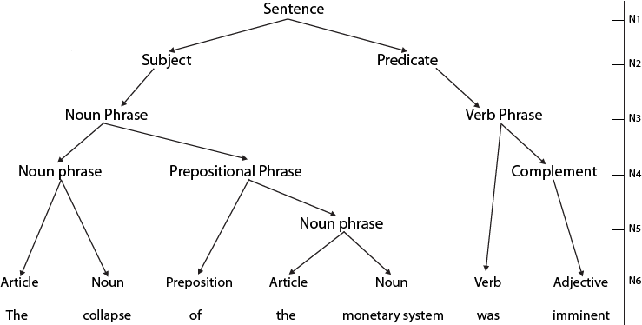
Syntactic Tree

Slide 33
Make a tree diagram for the following sentences
Some students will be studying late in their dormitories.
He washed the car and pollished it.
The room has got a large window which faces south.

Slide 34
Sentence
Subject
Predicate
Noun Phrase
Verb Phrase + other optional elements
are studying late in their dormitories.
VP+A+A
Some students
Det. + N
Some students are studying late in their dormitories.

Slide 35
Join kahoot, jamboard or slido
Play kahoot
PIN 9767048
https://create.kahoot.it/v2/share/syntax-clause-elements/d2adf2e3-38e3-4277-a107-0b9608b2eac9

Slide 36
Independent clause:
I will put the money in the bank or I will spend it. (two independent clauses)
A dependent clause (a subordinate clause)
She told me that she was going abroad.

